Slide 1
Interactions in an Ecosystem
ecosystem
abiotic factor
biotic factor
population
community
ecology
habitat
niche

Slide 2
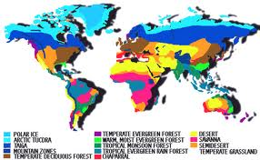
ecosystem – all the living and non-living things in an area
Click to access link!

Slide 3
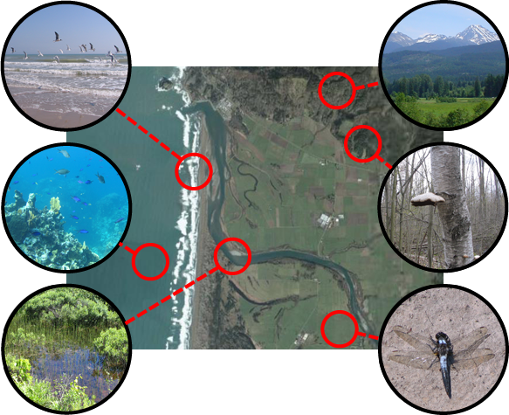
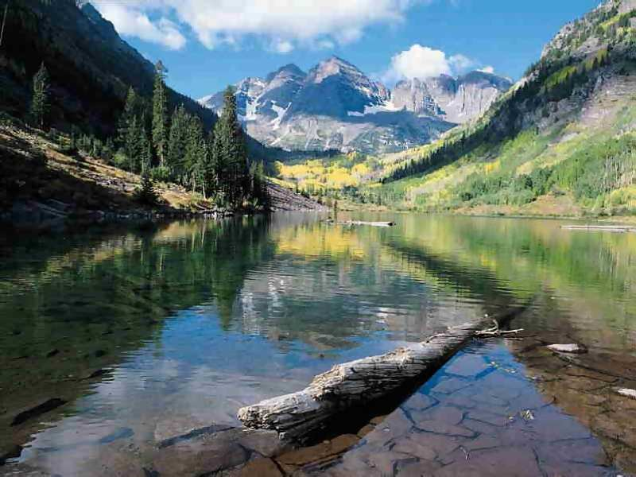
abiotic factor – the non-living parts of an ecosystem
water
minerals
light
air
temperature
soil

Slide 4
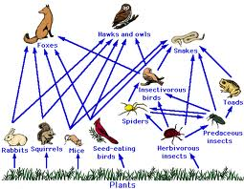
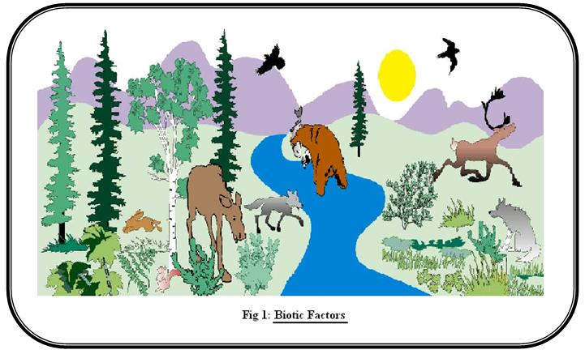
biotic factor – the living parts of an ecosystem
animals
plants
protists
bacteria
fungi

Slide 5
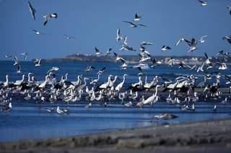
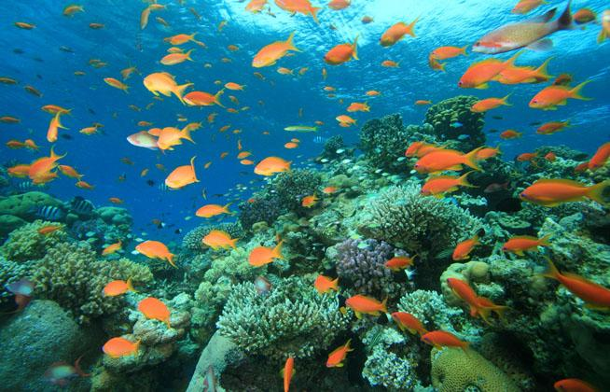
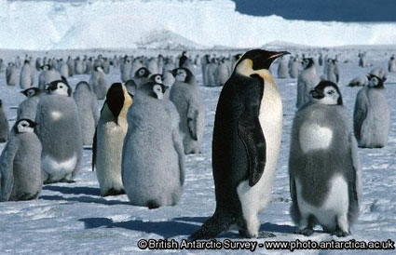
population – all the organisms of the same species living in an area

Slide 6
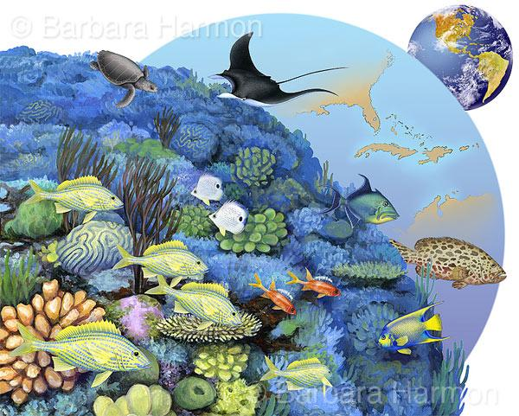
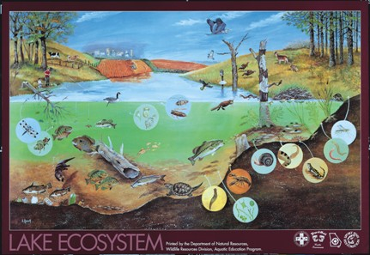
community – all the populations of plants and animals living in an area

Slide 7
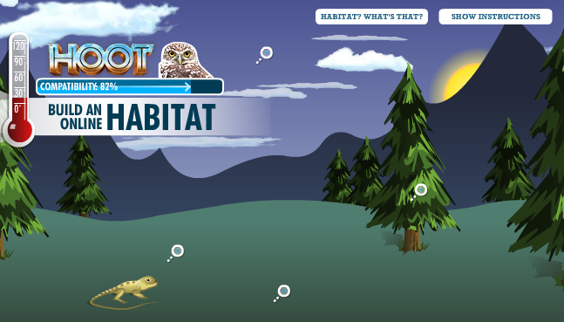
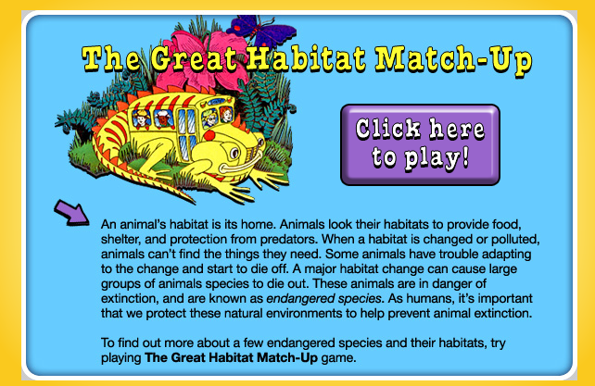
habitat – the place where an organism lives
Click pictures to access links!

Slide 8
niche – the role of an organism in its community
What does the species eat?
What eats the species?
What environment does the species need?
Is the species active by night or by day?
NO TWO SPECIES CAN FILL THE SAME NICHE!

