Slide 5
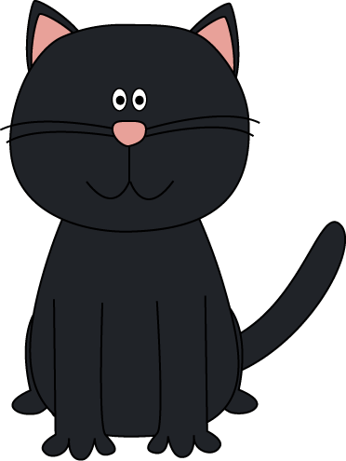
Inherited Traits
Animals and plants have inherited traits also
Two black cats will have black kittens
Seeds from a pink rose bush will produce more pink rose bushes
http://www.brainpop.com/science/cellularlifeandgenetics/heredity/
© LoveLearning 2014

Slide 19
Inherited Traits | Learned Behaviors
© LoveLearning 2014
http://safeshare.tv/w/pihwfqHJCO

Slide 20
Genes and Heredity
http://studyjams.scholastic.com/studyjams/jams/science/human-body/heredity.htm
© LoveLearning 2014

Slide 25
Bill Nye - Genes
© LoveLearning 2014
Notes:
Teachers – if the video is not available, it may have been taken down. Simply search “Bill Nye Genes” to find it again on YouTube.

Slide 26
Terms of Use
Thank you for downloading this product! Redistributing, editing, selling, or posting this resource on the internet (including your classroom website) are strictly prohibited unless you have gained permission from the author. Violations are subject to penalties of the Digital Millennium Copyright Act. If you would like to share this product with colleagues, please purchase the multiple user license.
More Resources:
Follow me for classroom ideas, updates, and freebies!

Slide 27
Graphics From:
www.teacherspayteachers.com/store/Lindy-Du-Plessis
www.mycutegraphics.com

